Slide 1
Data Analysis
Dr. Vinit Kumar

Slide 2
Data Analysis
Qualitative Analysis
Quantitative Analysis

Slide 3
Qualitative analysis
Applied in the case of observation and unstructured interview or questionnaire with open ended questions.
Content analysis: analysing the contents of the collected data in order to identify main themes that emerge from the responses given by the respondents.
Involves following steps:
Step 1: Identify the main themes
Step 2: Assign codes to the main themes
Step 3: Classify responses under the main themes
Step 4: Integrate themes and responses into the text of your report

Slide 4
Quantitative Analysis
== Statistical Analysis

Slide 5
Two types
Descriptive Statistics
Inferential Statistics

Slide 6
Descriptive Statistics
Summarize the data by describing what was observed in the sample Numerically or Graphically.
Numerical descriptors
Mean and standard deviation for continuous data types (like heights or weights),
Frequency and percentage for categorical data (like gender, race).
Graphical descriptors
Bar Graph, Line Graph, histogram, box plot, stem and leaf plot, Ogive etc.

Slide 7
Inferential Statistics
Uses patterns in the data to draw inferences about the population represented, accounting for randomness.
Inferences could be answering yes/no questions about the data (hypothesis testing)
Estimating numerical characteristics of the data (estimation),
Describing associations within the data (correlation),
Modelling relationships within the data (regression),
Prediction, extrapolation, interpolation, or other modelling techniques like ANOVA.

Slide 8
Introductory QA tools
Data description: Using tables and graphs (e.g., frequency, histograms, regression lines)
Data summaries : Using descriptive data (e.g., measures of central tendency and variability)
Data relationship : Correlation, chisquare test for independence
Decision making : Estimation , Hypothesis testing , Analysis of variance

Slide 9
Data Summaries
Measures of central tendency.
Also known as measure of location.
Mean
Median
Mode
Measures of dispersion.
Range
Mean deviation
Standard deviation
Variance

Slide 10
Type of
Measurement
Type of
descriptive analysis
Frequency table
Proportion (percentage)
Frequency table
Category proportions
(percentages)
Mode
Two
categories
Nominal
More than
two categories

Slide 11
Type of
Measurement
Type of
descriptive analysis
Ordinal
Rank order
Median

Slide 12
Type of
Measurement
Type of
descriptive analysis
Interval
Arithmetic mean

Slide 13
Type of
Measurement
Type of
descriptive analysis
Ratio
Index numbers
Geometric mean
Harmonic mean

Slide 14
Measures of central tendency

Slide 15
Central Tendency
Sometimes you just need to get to the heart of the matter.
It is a bit difficult to see patterns and trends in a big pile of figures.
By measuring the central tendency, you’ll be able to quickly find the most representative value in your data and draw important conclusions.

Slide 16
What ?
“A common way to describe a large set of data is to find a single number that represents what is the average or typical value of that set of data. Such a value is known as central tendency”
“A single expression, representing the whole group is selected which may convey a fairly adequate idea about the whole group”

Slide 17
Where?
Generally present in the central part of the distribution, where most of the data tend to be concentrated.
Purpose is to give you an idea about what is typical or common for a given set of data.

Slide 18
Most common measures
Mean (AKA Arithmetic mean)
Median
Mode
Not so common
Geometric mean
Harmonic mean
Weighted mean

Slide 19
Let us learn by an example

Slide 20
“The StatsLib”
Welcome to

Slide 21
The StatsLib
A public library prides for having perfect sections for everyone. Be it for reading, watching movies, listening songs, comics, literature, etc.
The staff of the library have noticed that the members seem happiest when they are in a section with people of their own age.
And happy users always come back for more in the library.

Slide 22
Important point
So the key to the success of the library is to work out what a typical age is for each of their sections.
Any suggestions about how to do this ???
Yeah, one way of doing this is to calculate the average
The average gives the representative age for each section, which the library staff can use to help their customers pick the right section for them.

Slide 23
Here are the current attendees of the comic reading section
20, 21, 20, 20, 19

Slide 24
Let us see first: mean
Before moving to mean a bit about letters and numbers in statistics.
Specific ages of attendees
19, 20, 20,20,21
General ages of attendies
X1, X2, X3,X4,X5
Each X represents one of the user ages
Sum= X1+X2+X3+x4+X5
What if we do not know how many numbers we have to sum?
X1+X2+X3+X4+X5+ ... +Xn
Member | Age
X1 | 19
X2 | 20
X3 | 20
X4 | 20
X5 | 21

Slide 25
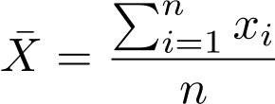

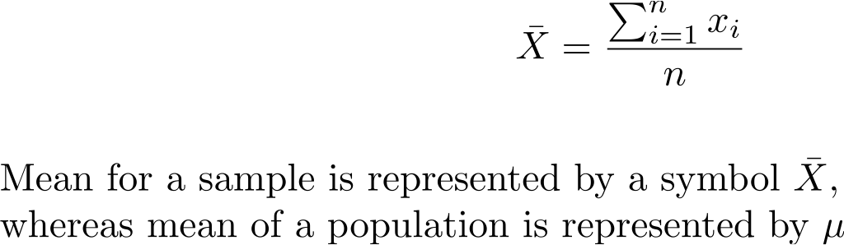
The formula for mean
∑x = Sum= X1+X2+X3+X4+X5+… +Xn
Mean= ∑x/n
Definition: A mean is the value that results when the sum of all the items in a series is divided by the number of items in a series.

Slide 26
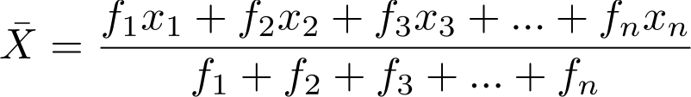
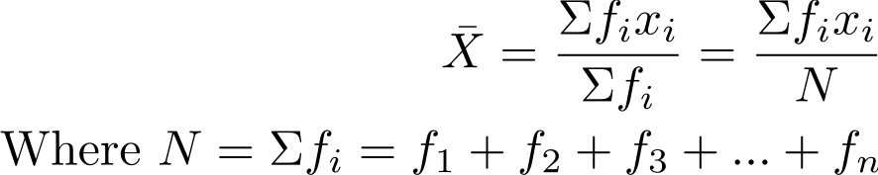
Methods to calculate mean
Arithmetic mean of an ungrouped data
N observations consists of n value denoted by X1, X2,X3 …,Xn of the observed variable x occurring with frequencies f1,f2,f3,f4,…,fn respectively then the arithmetic mean of the variable x is given by

Slide 27
For the Statslib example
Age | Frequency
19 | 1
20 | 3
21 | 1
Age | Frequency | fx
19 | 1 | 19
20 | 3 | 60
21 | 1 | 21
Total | N=5 | 100
= ∑fixi/N
=100/5
=20

Slide 28
Ex#8
Ex#8 : Find the arithmetic mean of following frequency table:
Marks | 52 | 58 | 60 | 65 | 68 | 70 | 75
Number of students | 7 | 5 | 4 | 6 | 3 | 3 | 2

Slide 29
Sol#8
Let x be the marks of the students and f be the frequency.
x | f | f X x
52 | 7 | 364
58 | 5 | 290
60 | 4 | 240
65 | 6 | 390
68 | 3 | 204
70 | 3 | 210
75 | 2 | 150
Total | N=30 | 1848

Slide 30
Applying the formula
Mean = ∑fiXi/N
1848/30 = 616/10=61.6
Ans: Mean marks obtained by student is 61.6.

Slide 31
To do
Attempt at least three problems having ungrouped data as data set to calculate the mean.

Slide 32
Arithmetic mean of grouped data
What if we have a frequency distribution with class intervals?
Ex#9
Find the average number of students attending class in a day.
No of students | 0-10 | 10-20 | 20-30 | 30-40 | 40-50 | 50-60
Number of days attending the class in a month | 2 | 6 | 9 | 7 | 4 | 2

Slide 33
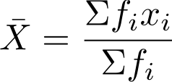
In such cases we need to take out the mid values of the classes and consider them as values of X.
So that the formula becomes:

Slide 34
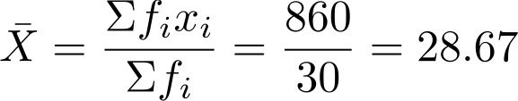
Sol#9
Number of students | Frequency (fi) | Mid value (xi) | fixi
0-10 | 2 | 5 | 10
10-20 | 6 | 15 | 90
20-30 | 9 | 25 | 225
30-40 | 7 | 35 | 245
40-50 | 4 | 45 | 180
50-60 | 2 | 55 | 110
Total | 30 |  | 860
Ans: On an average 29 students are attending classes per day.

Slide 35
These were direct methods to calculate mean

Slide 36
There is a shortcut method too

Slide 37
For discrete data
Used when the frequencies and the values of the variables are very large.
In such case it becomes very difficult to compute the arithmetic mean.
As a shortcut, we take a Provisional Mean or Assumed mean ‘a’.
Usually ‘a’ is that value of x which corresponds to the highest frequency or which comes near the middle value of the frequency distribution.

Slide 38
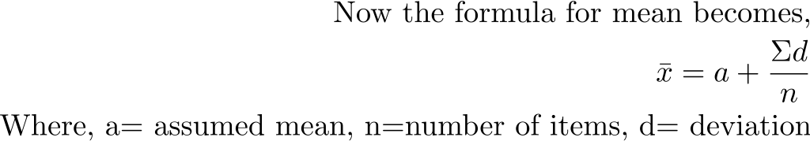
Also we find the deviations of each observation from the ‘assumed mean’ ‘a’.
So that

Slide 39
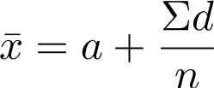
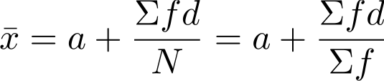
Working rules for shortcut method
Denote the variable of the discrete series by ‘x’.
Take the middle item as assumed mean and denote it by ‘a’.
Take the difference x-a and denote it by ‘d’.
Find the sum of all the deviations.
Use formula
For Grouped data:

Slide 40
Ex
The weight in kg of 60 students in a class is given below, find the mean weight by shortcut method.
Weight | 60 | 61 | 62 | 63 | 64 | 65
Number of students | 5 | 8 | 14 | 16 | 10 | 7

Slide 41
Weight (x) | No of students(f) | d=x-a | Fd
60 | 5
61 | 8
62 | 14
63 | 16
64 | 10
65 | 7
Total | ∑fi= |  | ∑fd=

Slide 42
Ex
Following table gives the distribution of total expenditure of students in an excursion.
Find the mean expenditure incurred by students using shortcut method.
Expenditure | 100-150 | 150-200 | 200-250 | 250-300 | 300-350 | 350-400 | 400-450 | 450-500
Number of students | 24 | 40 | 33 | 28 | 30 | 22 | 16 | 7

Slide 43
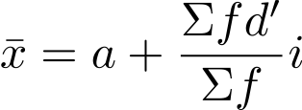
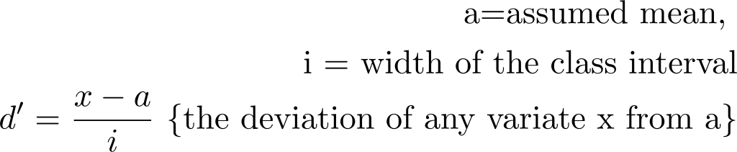
Step deviation method
Applied when the class distribution in grouped data are equal. Such as 0-10,10-20 etc..
Then the calculations can be simplified further by taking out the common factor from the deviations.
This deviation is equal to the width of the class interval.
Now the formula becomes ;

Slide 44
Ex
Following table gives the distribution of total expenditure of students in an excursion.
Find the mean expenditure incurred by students using standard deviation method.
Expenditure | 100-150 | 150-200 | 200-250 | 250-300 | 300-350 | 350-400 | 400-450 | 450-500
Number of students | 24 | 40 | 33 | 28 | 30 | 22 | 16 | 7

Slide 45
Expenditure | Mid value of ‘x’ | No of students (f) | dx=x-325 | d’x=dx/50 | fd’
100-150 |  | 24
150-200 |  | 40
200-250 |  | 33
250-300 |  | 28
300-350 |  | 30
350-400 |  | 22
400-450 |  | 16
450-500 |  | 7
 |  | N=

Slide 46

Back to “The StatsLib”
A 50 years old user
I am looking for a section where I can meet people of my age. Do you think you can help?

Slide 47
Check the library brochure
The first Section has a mean age of 17, the second has a mean of 25, and the mean age of the third one is 38.
Now, can you help her out ?

Slide 48
Let us see what happened then
A 50 years old user
I ended in a section with lots of youngsters and a few oldies. I’ll never ask you again. ☹

Slide 49
What might have gone wrong ??

Slide 50
Outliers
Member | Age
X1 | 19
X2 | 20
X3 | 20
X4 | 20
X5 | 21
X6 | 145
X7 | 149

Slide 51
Merits and demerits of Mean
Merits
Easy to calculate
Its calculation is based on all the observation
Easy to understand
It is rigidly defined by the mathematical formula
Obtained by calculation and does not depend upon any position
Demerits
The extreme values have greater effect on mean
Can’t be calculated if all the values are not known
Can not be determined for qualitative data, such as Beauty, honesty etc.

Slide 52
To sum up
Mean

Slide 53
Median
If the mean becomes misleading because of skewed data and outliers, then we need some other way of saying what a typical value is.
We can do this by, quite literally, taking the middle value.
This is a different sort of average, and it’s called the median.

Slide 54
Median
To find the median of the comic reading section, line up all the ages in ascending order, and then pick the middle value, like this:
19 19 20 20 20 21 21 145 147
So, here 20 is the median.

Slide 55
Let us define it.
“Median is defined as the middle most or the central value of the variable in a set of observations, when the observations are arranged either in ascending or in descending order of their magnitudes.”
It divides the arranged series in two equal parts.
It is position average, whereas mean is calculated average.

Slide 56
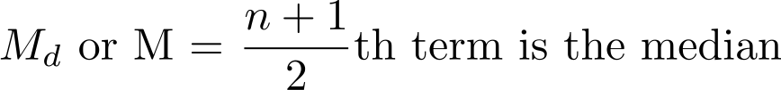
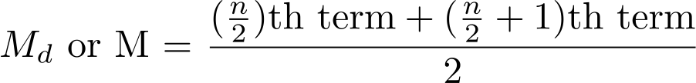
Methods to calculate
For ungrouped data:
Case 1: When n is odd
Case 2: When n is even, Median is the arithmetic mean of two middle terms.

Slide 57
Ex
The following is the distribution to show number of cards prepared by different cataloguers in a library
5,19,42,1,50,30,21,0,52,36,27
Xerox taken by faculty in a department.
6,10,4,3,9,11,22,18
Calculate the median for both of them.

Slide 58
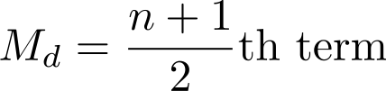
For a frequency distribution
Case 1: When the series is discrete.
The values of the variable are arranged in ascending or descending order of magnitudes.
A table is prepared showing the corresponding frequencies and cumulative frequencies.
Check whether N=number of observations or Efi is ODD or EVEN.
If ODD: Find the cumulative frequency for
and determine the corresponding value of the variable.
If EVEN: Find the cumulative frequency for
and determine the corresponding value of the variable.
The value obtained in the above step is the required median.

Slide 59
Ex
For this distribution:
Marks | 20 | 9 | 25 | 50 | 40 | 80
Number of students | 6 | 4 | 16 | 7 | 8 | 2

Slide 60
Marks (X) | No of students(f) | C.f.
9 | 4
20 | 6
25 | 16
40 | 8
50 | 7
80 | 2
 | N=43

Slide 61
Find the median of following distribution
X: 5, 7, 9, 12, 14, 17, 19, 21
f: 6, 5, 3, 6, 5, 3, 2, 4

Slide 62
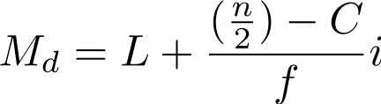
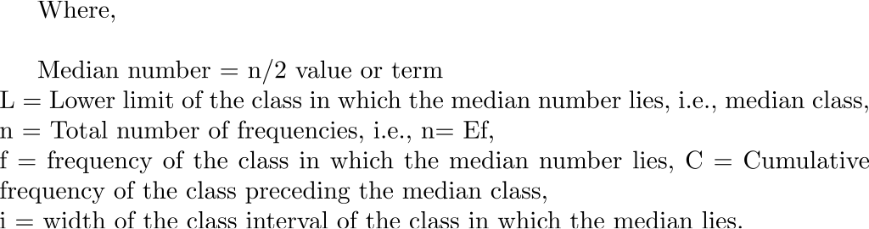
For grouped data
Case 2: The series is discontinuous
The data is given in the form of a frequency table with class intervals etc.
And the formula to ascertain median is :

Slide 63
Ex
The following table gives the weekly expenditure of 100 families. Find the median weekly expenditure.
Weekly Expenditure | No of Families
0-10 | 14
10-20 | 23
20-30 | 27
30-40 | 21
40-50 | 15

Slide 64
Weekly Expenditure | No of Families | CF
0-10 | 14 | 14
10-20 | 23 | 37
20-30 | 27 | 64
30-40 | 21 | 85
40-50 | 15 | 100
Median Number = (n/2)th value = 100/2=50th value
The 50th value will lie in class 20-30 this is known as median class.
Here n/2=50, L=20, C=37, f=27 & i=10
Putting the values in formula:
=20+(50-37)/27 x10
20+4.815=24.815 is the median weekly expenditure.

Slide 65
Ex
Scores | No of students
0-5 | 6
5-10 | 12
10-15 | 50
15-20 | 120
20-25 | 225
25-30 | 250
30-35 | 185
35-40 | 110
40-45 | 32
45-50 | 10
Scores of 1000 students are:

Slide 66
The StatsLib Members are soaring
Hi, I am in 30’s. I think it is too late to learn, I would feel a bit comfortable if I get people of my age. Can u help me out?
A 30 years old user

Slide 67
According to the library brochures Cookery SectionW has mean age of 34 and that is median too.
So the SectionW was suggested.

Slide 68
☹
A 30 years old user
Better I enjoy whatever I know.

Slide 69
So what might have gone wrong ?

Slide 70
Let us see the data
The ages of people in this section are
10 11 12 12 13 13 14 15 34 40 42 46 54 60 66 67 67
Actually in that section there were some old people brought their relatives to teach cookery. ☺
Both median and mean are misleading.
And it fluctuates wildly if other people join the section.

Slide 71
Merits and demerits of Median
Merits
It is not affected by the extreme values.
It can be located graphically
It can be easily located even if the class intervals in the series are unequal.
Demerits
It is not subject to algebraic treatments.
It is positional average and based on the middle value only
It is estimate in case of series containing even number of items
It does not take into account all the values.
It is not suitable in those cases where due importance and weight should be given to extreme value.
Use:
Useful where numeric measurement is not possible.
Use to study phenomena like time spent to search a doc.

Slide 72
To sum up

Slide 73
Mode
Another type of average.
“Mode is that value in a series which occurs most frequently”
In a frequency distribution mode is that variate which has maximum frequency.
It represents most typical, frequent and predominant value.
6,5,3,4,3,7,8,5,9,5,4

Slide 74
A show shop has sold 100 pairs of shoes on a particular brand on a certain day. What is the mode size ?
SIZE | No of pairs
4 | 10
5 | 15
6 | 20
7 | 35
8 | 10
9 | 3
10 | 1

Slide 75
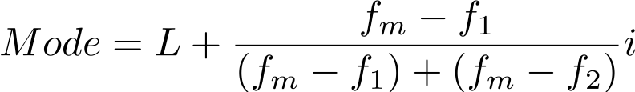
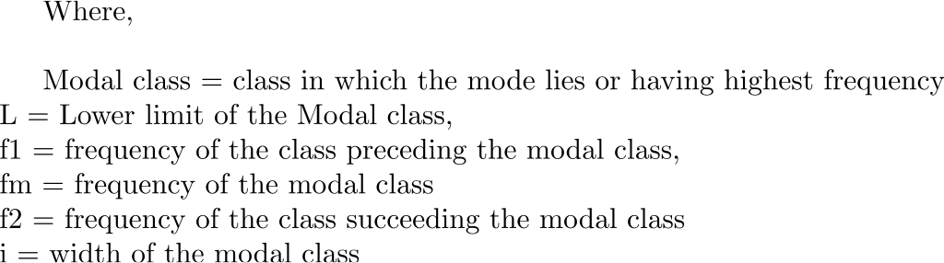
For grouped data, the formula becomes

Slide 76
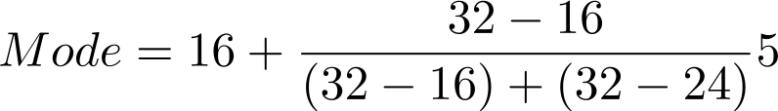
Calculate mode of following distribution:
L =16, fm=32, f1=16, f2= 24, i=5
Marks | 1-5 | 6-10 | 11-15 | 16-20 | 21-25
Number of students | 7 | 10 | 16 | 32 | 24

Slide 77
Seeing the mode age I was able to decide the appropriate section for me.
A 50 years old user

Slide 78
Me too.
A 30 years old user

Slide 79
There can be more than one mode in a series. Known as Bimodal
And there can be no mode.

Slide 80
Merits and demerits of Mode
Merits:
Easily understood
Located just by inspection
Can be graphically ascertained
Not affected by extreme values.
Arrangement of data is not necessary.
Best measure for categorical data.
Demerits:
More than two modes creates confusion
Algebraic treatments can not be done.
Use
To study most popular fashion.

Slide 81
To sum up:

Slide 82
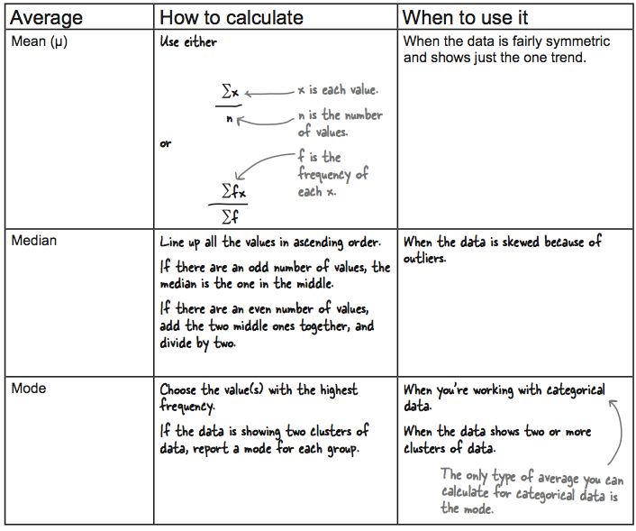

Slide 83
The curious case of Salary
The staff at a The StatsLib are feeling mutinous about perceived unfair pay. Most of them are paid Rs 500 per week, a few managers are on a higher salary, and the Head Librarian takes home Rs 49,000 per week.
“The average salary here is Rs 2,500 per week, and we’re only paid Rs 500,” say the para-professional staff . “This is unfair, and we demand more money.”
One of the managers overhears this and joins in with the demands. “The average salary here is Rs 10,000 per week, and I’m only paid Rs. 4,000. I want a raise.”
The Head Librarian looks at them all. “You’re all wrong; the average salary is Rs 500 per week. Nobody is underpaid. Now get back to work.”
What do you think is right?

Slide 84
Para-professionals – median
Managers – mean (CEO salary is skewing the data to right)
Head Librarian - mode

Slide 85
Scales of measurement and Measures of central tendency
Nominal Data | Calculation of proportions, percentages, ratios, rates of change, mode
Ordinal Data | Calculation of mode
Ratio or Interval Data | Calculation of mean, median, mode (mean deviation, standard deviation, coefficient of variability)

Slide 87
Measures of dispersion
Dr. Vinit Kumar

Slide 88
Measure of central tendency gives us a single central value that represents the entire data.
But they do not reveal the degree of spread or extent of variability of individual items in a distribution.
Therefore the measure of central tendency is insufficient.

Slide 89
 | Maths | Computer | Science
Rahul | 40 | 50 | 60
Anjali | 20 | 50 | 80
Here,
The mean is same i.e, 50 Marks
But the performance of Rahul is better than anjali, since anjali failed in one subject
Also Rahul’s marks vary between = Mean -10 to mean +10
For Anjali it is = Mean -30 to mean +30
Such a variation present in data is measured through measures of dispersion.

Slide 90
graph

Slide 91
Definition
The degree to which numerical data tend to spread about an average value is called variation or dispersion of data.
Dispersion or spread is the degree of the scatter or variation of the variable about a central value.
Averages of second order.
Used in two senses:
Relates to the limits within which the data fall
Accounts to the amount, absolute of relative by which the values of the items differ from average.

Slide 92
Significance
To determine the reliability of an average
To serve as a basis for the control of variability
To compare two or more series with regard to their variability
To facilitate the use of other statistical measures, Such as correlation, regression etc.

Slide 93
Methods of studying variation
The Range
The mean deviation
The standard deviation
The variance

Slide 94
Absolute Measures of dispersion
Expressed in same statistical unit in which the original data are given such as Rs, KG, etc
Used to compare the variation in two distributions provided the variables are expressed in the same units and of same average size.
Relative Measures of dispersion
The ratio of a measure of absolute dispersion to an appropriate average.
AKA “Coefficient of dispersion”

Slide 95
Range
Simplest measure of dispersion
It is the difference between the minimum and the maximum item of the series.
20,21,22,25,30,32,37,47,65

Slide 96
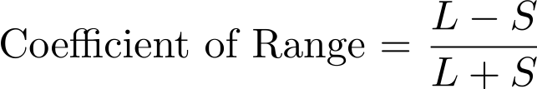
Absolute Range= Xmax-Xmin
=L-S
L= Largest Item, and
S= Smallest Item
Relative,
Coefficient of Range= Absolute Range/Sum of two extremes

Slide 97
So we can say,
If the average of the two distributions are same, a comparison of the range indicates that the distribution with the smaller range has less dispersion, and the average of that distribution is more typical of the group.

Slide 98
Ex.
The following are the books issued by The StatsLib in the last seven years.
Calculate the range and its coefficient.
Year | Books issued
2011 | 200
2010 | 210
2009 | 208
2008 | 160
2007 | 220
2006 | 250

Slide 99
For grouped data
Two methods:
Find the difference between the upper limit of the highest class and the lower limit of the lowest class.
Subtract the mid-point of the lowest class from the mid-point of the highest wage class.
In Practice both the methods are used.

Slide 100
Ex.
Calculate Coefficient of range from the following data.
Marks | No. of Students
10-20 | 8
20-30 | 10
30-40 | 12
40-50 | 8
50-60 | 4
60-10/60+10=50/70=0.714

Slide 101
Merits and demerits of Range
Merits:
Easiest to understand
Simplest and easy to calculate
Quick and dirty way to compute variability
Algebraic treatments can be applied.
Demerits:
Not based on each and every item of the distribution.
Subject to sampling fluctuations
Range only considers the extreme values, so it can’t tell us the character of the distribution.
Range cannot be computed in an open ended distribution

Slide 102
Ex.
Observe the following three series:
Series A | 46, 6, 46, 46, 46, 46, 46, 46
Series B | 6, 10, 6, 6, 46, 46, 46, 46
Series C | 6, 6, 15, 25, 30, 32, 40, 46
Here, in all the three series range is same, i.e., 46-6=40. but it does not mean that the distributions are alike.

Slide 103
Mean Deviation
The range an the interquartile range are not measures of dispersion in the strict sense of the term because they do not show the scatteredness/spread around an average.
The two other measures:
Mean deviation
Standard deviation
Will help us in achieving this goal.

Slide 104
Mean Deviation
Average deviation.
Mean deviation of a series is the arithmetic mean of all the deviations, without their algebraic signs, taken from its central value(Mean or median or mode)
“Average of the modulus of the deviations of the observations in a series taken from mean or median or mode”.

Slide 105
In other words
It calculates the variations of the value of individual items in the series:
The central value can be any average.
The sum of deviations of items from median is minimum.
In practice mean is more frequently used.
The algebraic signs of the deviations is always positive.
B’coz the sum of all deviation will always be ZERO.
3, 5, 13, 14, 15, 16

Slide 106

Computation
If x1, x2, x3, ….. Xn are n given observations then the deviation about the average is given by :
Disregarding the signs and considering only the absolute values it becomes:
And the sum of each deviation:

Slide 107
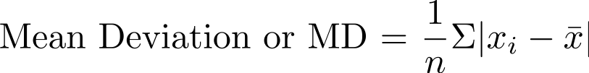
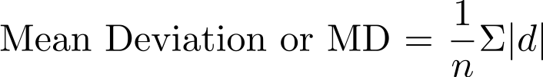
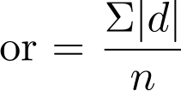

Slide 108
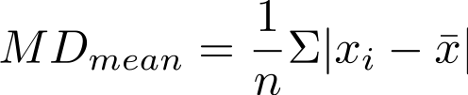
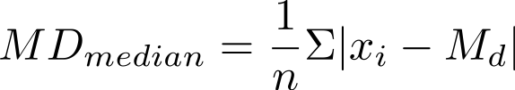
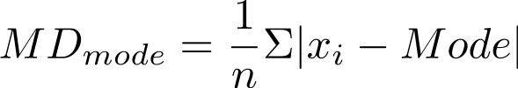

Slide 109
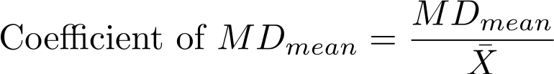
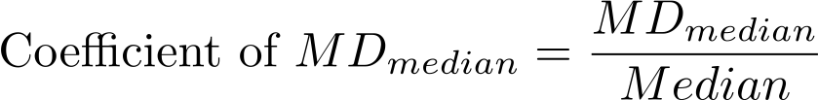
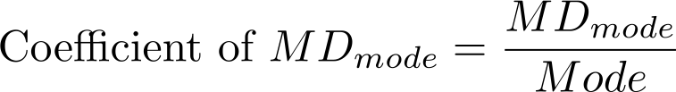
Coefficient of MD
The relative measure for mean deviation is known as “coefficient of Mean Deviation” and is obtained by dividing mean deviation by the particular average used in computing MD.

Slide 110
Ex
Calculate the Mean Deviation about the mean for the following series:
15, 20, 17, 19, 21, 13, 12, 10, 17, 9, 12
Steps:
Compute the mean of the series.
The deviations of the items from mean and denote it by “|d |”
Obtain the total of these deviations, i.e., ∑|d|
Divide the total obtained in last step by the number of observations.

Slide 111
X | X-Mean=d | |d|
15
20
17
19
21
13
12
10
17
09
12
N= |  | ∑|d|=

Slide 112
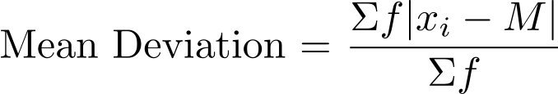
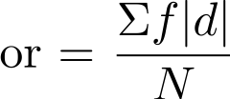
MD for grouped data
For x1,x2,x3, … xn occur with frequencies f1,f2,f3,….fn respectively.
M= Mean or Median or Mode

Slide 113
ex
Calculate the mean deviation about the mean for the following series.
X | 10 | 11 | 12 | 13 | 14
f | 3 | 12 | 18 | 12 | 3

Slide 114
ex
Calculate the mean deviation about the mean for the following series.
9,12,10,11,8,13,11,12,10,11,12,11,8,11,16,11

Slide 115
Assignment :
Calculate mean deviation about the median and its coefficient from the following data:
Class | Frequency
0-10 | 5
10-20 | 8
20-30 | 12
30-40 | 15
40-50 | 20
50-60 | 14
60-70 | 12
70-80 | 6

Slide 116
Variance
In mean deviation if we consider the signs the average distance from the mean will cancle to zero.
1,2 and 9.

Slide 117
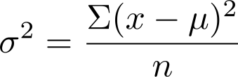
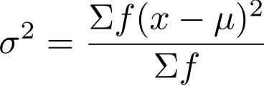
Another way to make the distances positive is by taking square of them.
We will always get a positive number and the average won’t cancel out. This kind of measure of dispersion is known as Variance.

Slide 118
Standard Deviation
Variance gives the spread in terms of distance squared. So it becomes tough to understand it.
So if we a take root of variance we will get spread which will be little more understandable.
Introduced by Karl Pearson
also known as root mean square deviation.
It is positive square root of the mean of the squared deviations from the arithmetic mean.
Denoted by small letter

Slide 119
Use
Measures the absolute dispersion (variability)
The greater the amount of dispersion the greater the standard deviation of the values from their mean.
A small SD means a high degree of uniformity of the observation as well as the homogeneity of the series

Slide 120
Thus if we have two or more comparable series with identical or nearly identical means, it is the distribution with the smallest SD that has the most representative mean.
SD is extremely useful in judging the representativeness of the mean.

Slide 121
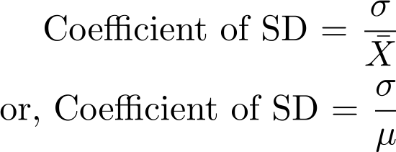
Coefficient of standard Deviation

Slide 122
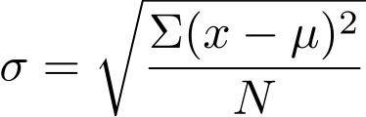
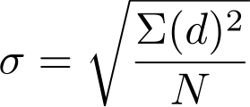
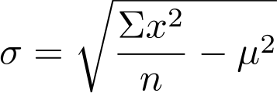
Calculation
For ungrouped data

Slide 123
Ex.
Find the standard deviation and variance of the following series:
3, 4, 5, 6

Slide 124
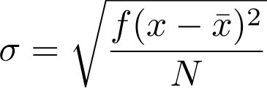
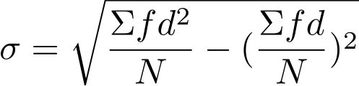
For grouped data
Actual Mean method or direct method
Assumed mean method
Here d= x-A
A = assumed mean
N= ∑f

Slide 125
Ex.
Find S.D. and coefficient of SD for the following
Size | 10 | 11 | 12 | 13 | 14 | 15 | 16
Frequency | 2 | 7 | 11 | 15 | 10 | 4 | 1

Slide 126
Working rule
Take any item of the given series as assumed mean A.
Take the deviations of the items from the assumed mean A and denote it by “d”.
Multiply the deviations by the respective frequency and denote it by fd. Obtain the total of this column.
Calculate d2.
Multiply the squared deviations by respective frequency to get fd2. Obtain the total of this column.

Slide 127
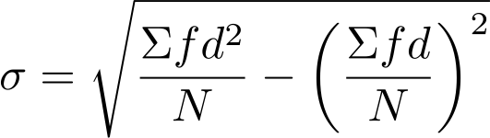
Find the value of

Slide 128
Size of the item | Frequency (f) | d=x-A | Fd | d2 | fd2

Slide 129
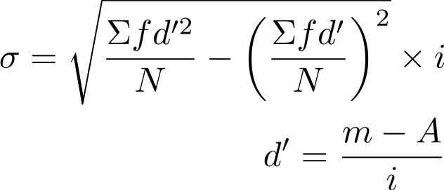
For Continuous series
i=class interval (or the common factor in case the class intervals are unequal)
m= mid value of the interval
A = Assumed mean

Slide 130
Working rule
Find the mid values or mid points of the various class and denote it by m.
Take any one value of ms as the assumed mean A.
Take the deviations of the mid-points from the assumed mean A and divide it by class interval or common factor i. Denote it by d’
Multiply the respective frequencies ‘f’ with the corresponding deviation d’ and obtain ∑fd
Square the deviations d’ and multiply it with their respective frequencies obtain ∑fd2
Put the values in the formula.

Slide 131
Ex.
Find the SD for the following distribution
Marks | 10-20 | 20-30 | 30-40 | 40-50 | 50-60 | 60-70 | 70-80
No. of Students | 5 | 12 | 15 | 20 | 10 | 4 | 2

Slide 132
Marks (class interval) | No. of student | mid-value (m) | d=m-A/i | fd | fd2

Slide 133
Assignment
Find the SD for the following data:
CI | 0-10 | 10-20 | 20-30 | 30-40 | 40-50 | 50-60 | 60-70
f | 6 | 14 | 10 | 8 | 1 | 3 | 8

Slide 134
The SD enables us to determine, with a great deal of accuracy, where the values of a frequency distributions are located with the help of Tchebycheff’s theorem.
It says: No matter what the shape of the distribution is, at least 75 % of the values will fall within ±2 SDs from the mean of the distribution,
And at least 89 % will lie in ±3 SDs from the mean.

Slide 135
For a symmetrical distribution, the following relationships hold good:
Mean ±1 covers 68.27% of the items.
Mean ±2 covers 95.45% of the items.
Mean ±3 covers 99.73% of the items.

Slide 136
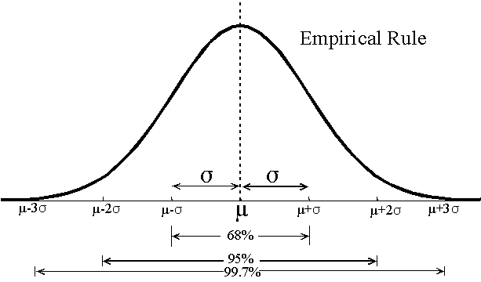

Slide 137

Coefficient of variation
Relative measure of dispersion.
It is always in percentage.
Used to compare the variability of two series.
The series for which CV is greater is said to be more variable (or less consistent)

Slide 138
The quarterly circulation of three libraries are given below.
 | A | B | C
Jan-March | 9.5 | 15.5 | 3.3
April-June | 13.7 | 21.2 | 5.7
July-Sept | 10.4 | 23.4 | 8.9
Oct-Dec | 8.6 | 18.8 | 2.6

Slide 139
The arithmetic means of entries prepared by three cataloguers Jay, Viru and Gabbar in the StatsLib are 50, 48, 12 respectively.
The SD of their efficiencies are 15, 12, 2. Who is most consistent cataloguer? Who should be promoted?

Slide 140
Thanks
Send your queries to :
mailvinitkumar@gmail.com

